Slide 1

Electrical Vehicle Motor Temperature Rise Prediction
By
HARSHAD BANDI

Slide 2
INTRODUCTION
The environmental friendly electric vehicles market is advancing in India. New car companies are transforming the car industry, creating innovative new models. Interest in the electric vehicles market is growing rapidly and with new pricing models the growth is predicted to get bigger.
India broke into the top three largest car markets in the world in 2022 and continues to grow. With over 40 crores (400 million) people in need of transport solutions, the Government of India is pushing for the adoption of electric vehicles (EVs) to reduce fuel consumption and improve the environment.
Electric vehicles produce less life cycle emissions than traditional cars. Electricity emissions are lower because creating electricity requires burning less gasoline or diesel. Another reason that electric vehicles are our future is because they are more energy efficient than internal combustion engine cars.

Slide 3
What is permanent magnet synchronous motors(PMSM) ?
How permanent magnet synchronous motors(PMSM) Will increase Efficiency ?
Permanent magnet synchronous motors (PMSM) have high power density, stable output torque, low noise, and good speed regulation performance, making them very suitable for electric vehicle propulsion
PMSM is widely used in Electrical Vehicles ,robotics, machine tools, actuators, and it is being considered in high-power applications such as industrial drives and vehicular propulsion.
In an electric vehicle, when the driver applies the accelerator, the battery in the car supplies electricity to the stator, causing the rotor to turn, and subsequently provide mechanical energy to turn the car's gears. Once the gears are rotating, the wheels turn too. More the efficiency of the Motor More the Efficiency of the Electric Vehicle.

Slide 4
Overview
PMSM is widely used in Electrical Vehicles ,robotics, machine tools, actuators, and it is being considered in high-power applications such as industrial drives and vehicular propulsion.
Motor in Electrical Vehicles(EV's)
Research shows that temperature rise in the electric motor is one of the main components of an EV which negatively affects the performance of the EV . It leads to high failure rates, heating problems may catch fire and a shortened life span, which reduce the overall efficiency and performance of EVs.
Motor Productivity and Maintenance
Being able to have strong estimators for the rotor temperature helps the automotive industry to manufacture motors with less material and enables control strategies to utilize the motor to its maximum capability. A precise torque estimate leads to more accurate and adequate control of the motor, reducing power losses and eventually heat build-up.On the rotor part, irreversible demagnetization of the permanent magnets can be caused by overheating, which represents an even more severe instance of motor damage.

Slide 5
PROBLEM STATEMENT
The aim of this project is to predict the Motor temperature of a permanent magnet synchronous motor (PMSM) using Different Regression models. As suggested in the explanatory notes of the dataset, sensor measuring all the different temperatures of the motor and the torque are not reliable nor economically feasible in commercial applications. A sufficiently accurate prediction model would therefore eliminate the need for sensor measurements to determine the permanent magnet temperature

Slide 6
03
Requirements analysis
Exploratory data analysis
Contents of Project
02
01
Machine learning Model to predict Temperature.

Slide 7





METHODOLOGY
Requirement Analysis
Data is collected from various sources.
Conclusion and Interpretation
In the End, after all the Analysis and Model Predictions, the Conclusions are Made
Exploratory Data Analysis
The dataset is being investigated to discover hidden patterns and anomalies.
Model Building
After Data Preparation we Build Different Regression Models to Predict the Desired Temperature of Motor.
Data Preparation
Data preparation is the process of preparing raw data so that it is suitable for further processing and Model Building.

Slide 8
About Dataset
The data has been downloaded from a dataset in Kaggle provided by Paderborn University (Germany).The model was trained on the Electric Motor Temperature dataset which contains data collected from different testing sessions on the same PMSM with 2Hz sampling rate.
Here we have 13 features. In which 12 Features are Float values and 1 Feature is Int.
Data Definition
Ambient - Ambient temperature as measured by a thermal sensor located closely to the stator.
coolant - Coolant temperature. The motor is water cooled. Measurement is taken at outflow.
u_d - Voltage d-component
u_q - Voltage q-component
motor_speed - Motor speed
torque - Torque induced by current.
i_d - Current d-component

Slide 9
i_q - Current q-component
pm - Permanent Magnet surface temperature representing the Motor temperature. This was measured with an infrared thermography unit.
stator_yoke - Stator yoke temperature measured with a thermal sensor.
i_d - Current d-component
stator_tooth - Stator tooth temperature measured with a thermal sensor.
stator_winding - Stator winding temperature measured with a thermal sensor.
This Dataset contains 13,30,801 data points across 13 Features
The data has been downloaded from a dataset in Kaggle provided by Paderborn University (Germany).
Link : https://www.kaggle.com/competitions/electric-motor-temperature/data?select=test.csv

Slide 10
STEPS FOLLOWED IN EDA
2
4
3
5
1
Visualizing the Data using Seaborn and Matplot Library.
Treating of Outliers and Treating Missing Values.
Statistical Analysis of Variables.
Finding Correlation between the Different Features.
Understanding the Data.

Slide 11
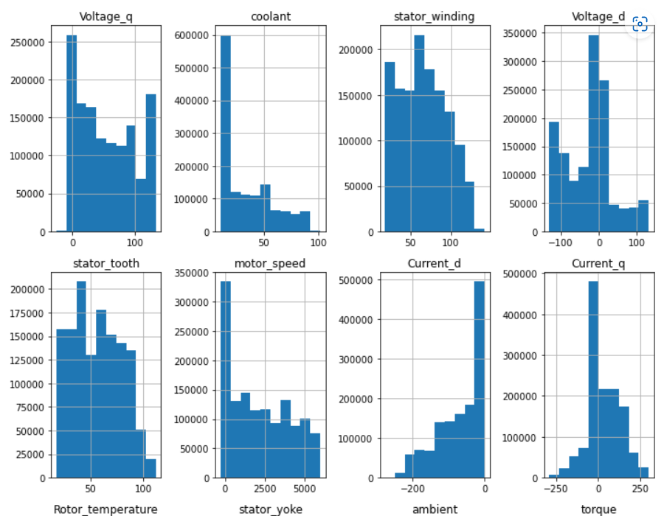
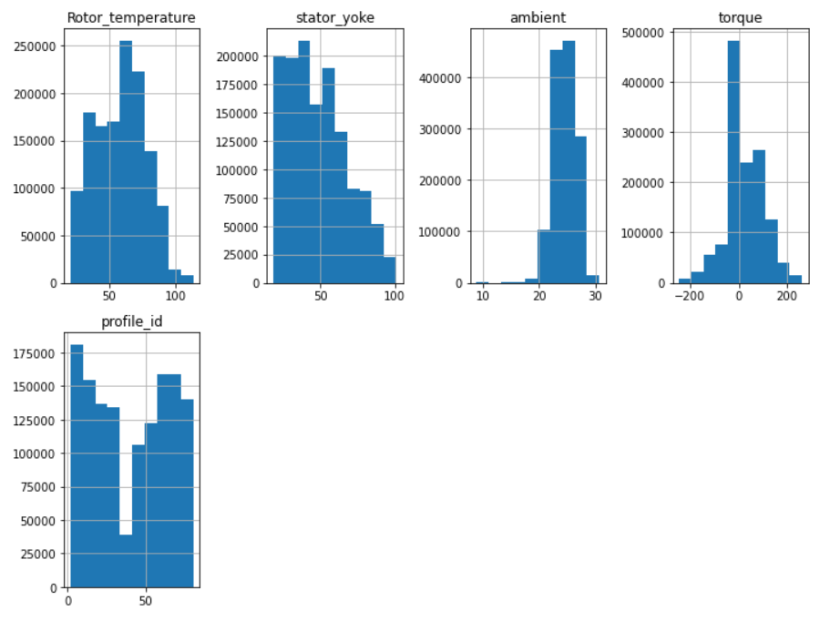
DATA VISUALIZATION
INSIGHTS
Distributions are not very gaussian
we often have multi-modal distributions,
Some features show a significant spike in their distribution. This is reasonable as these are the values that are held during no excitation (resting/cooldown phase) target temperatures are less spikey, indicating a slower progress or response to input features (read 'greater time constants')

Slide 12
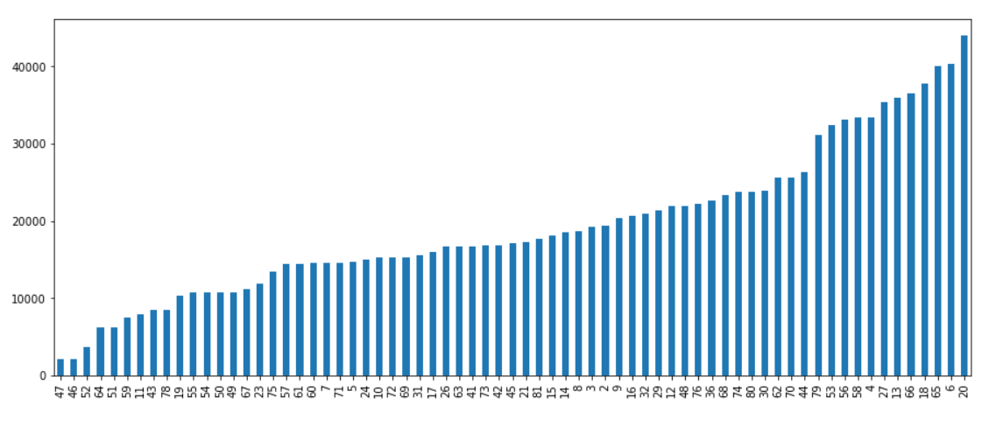
DATA VISUALIZATION
INSIGHTS
As we can see, session ids 65, 6 and 20 have the most number of measurements recorded

Slide 13
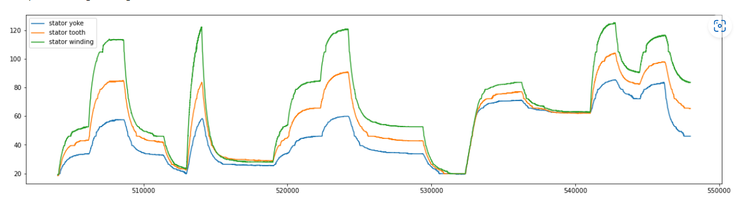
DATA VISUALIZATION
INSIGHTS
As we can see from the plot, all three stator components follow a similar measurment variance.
As the dataset author mentioned, the records in the same profile id have been sorted by time, we can assume that these recordings have been arranged in series of time.
Due to this we can infer that there has not been much time given for the motor to cool down in between recording the sensor data as we can see that initially the stator yoke temperature is low as compared to temperature of stator winding but as we progress in time, the stator yoke temperature goes above the temperature of stator winding

Slide 14
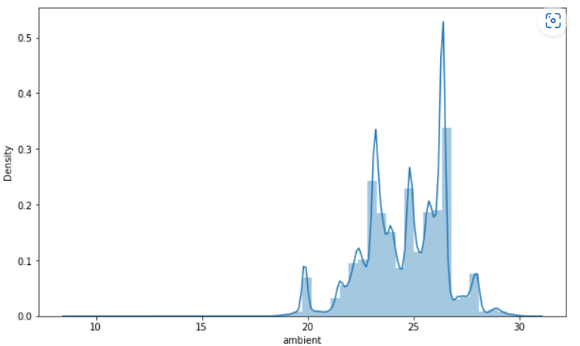
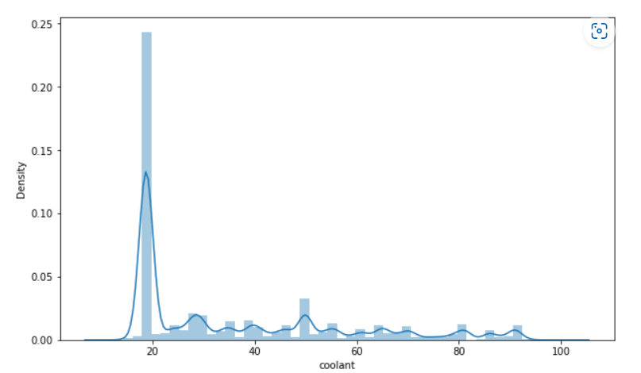
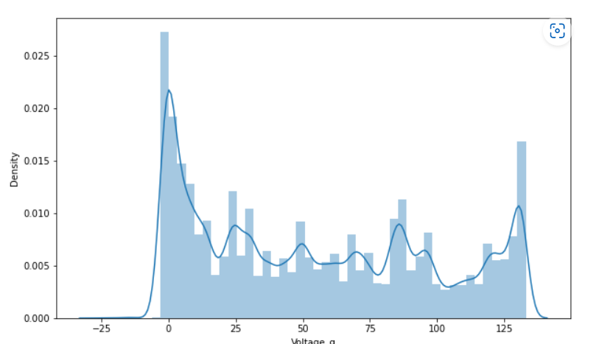
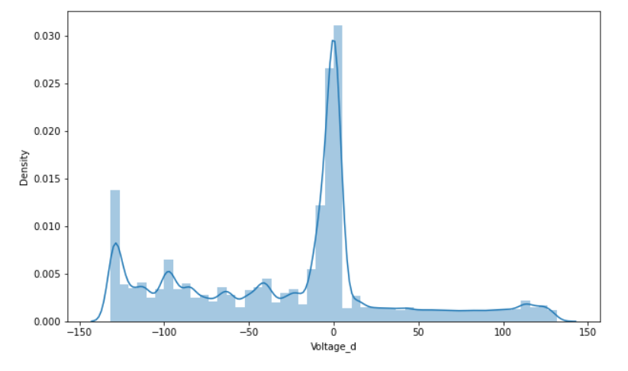
DATA VISUALIZATION
pvalue is less than 0.05. So we reject the null hypothesis and can say that variance for ambient temperature is not equal to the variance of rotor temperature.
pvalue is less than 0.05. So we reject the null hypothesis and can say that variance for voltage d-component is not equal to the variance of rotor temperature.
pvalue is less than 0.05. So we reject the null hypothesis and can say that variance for voltage q-component is not equal to the variance of rotor temperature.
pvalue is less than 0.05. So we reject the null hypothesis and can say that variance of motor speed is not equal to the variance of rotor temperature

Slide 15
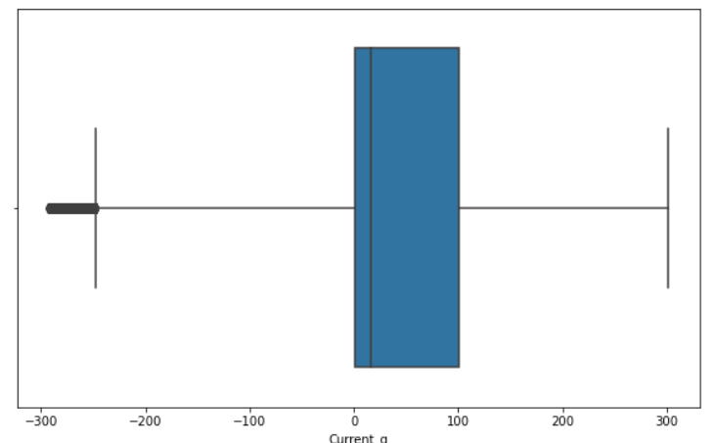

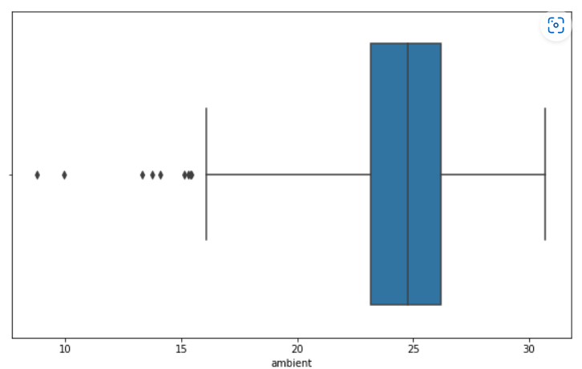
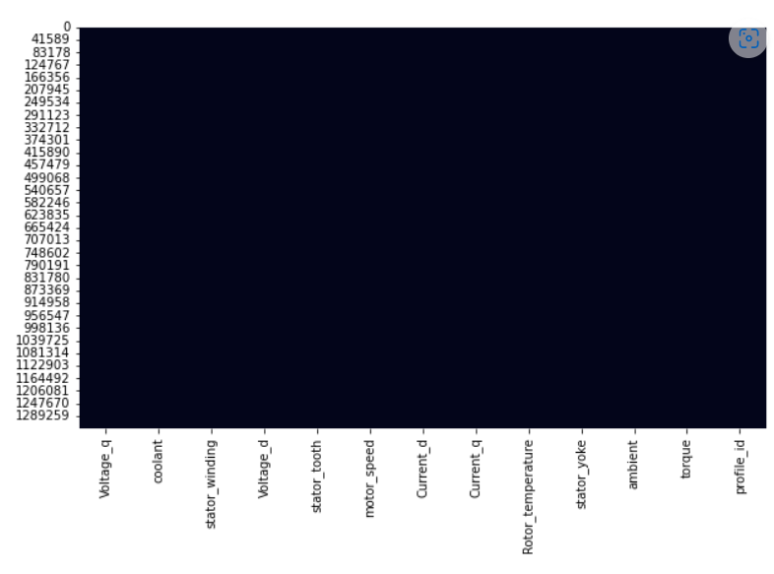
TREATING OUTLIERS AND MISSING VALUES
OUTLIERS DISCOVERY
After plotting Boxplot we found some severe Outliers in Current_q, Torque and Ambient.
After Finding Outliers the best treatment we did is we removed the Outliers.
From the given Heatmap we can see that there are NO Missing Values which is best for the Model Building i.e We will Get good Accuracy.

Slide 16
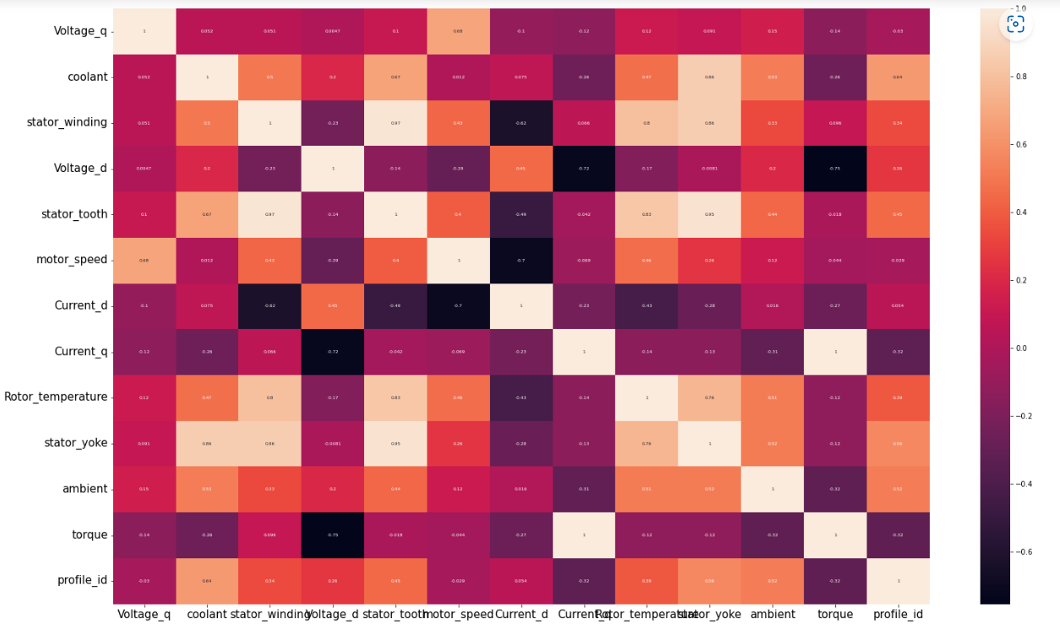
COMPARISON ON WORK TYPE
From the above Heatmap we can see that torque is highly co-related with Current_q
Also Stator_winding is highly correlated with stator_tooth

Slide 17
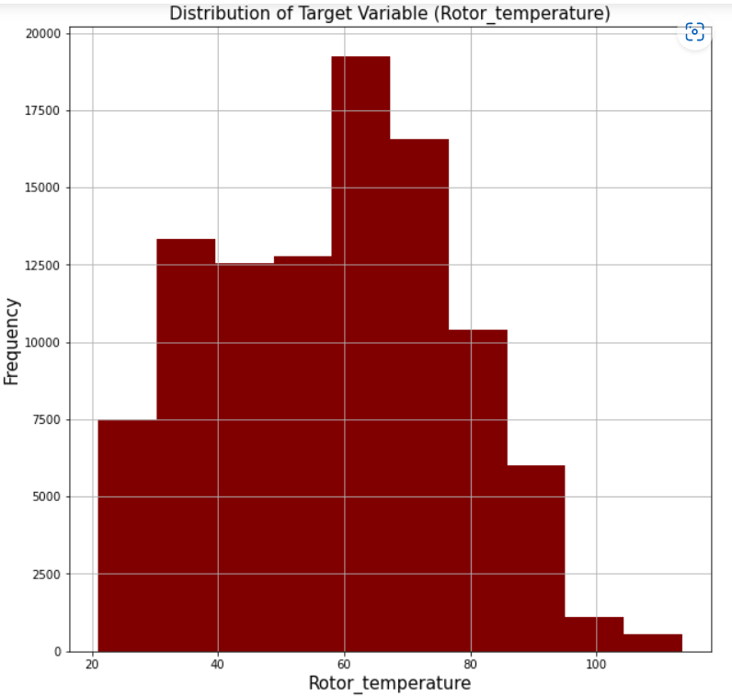
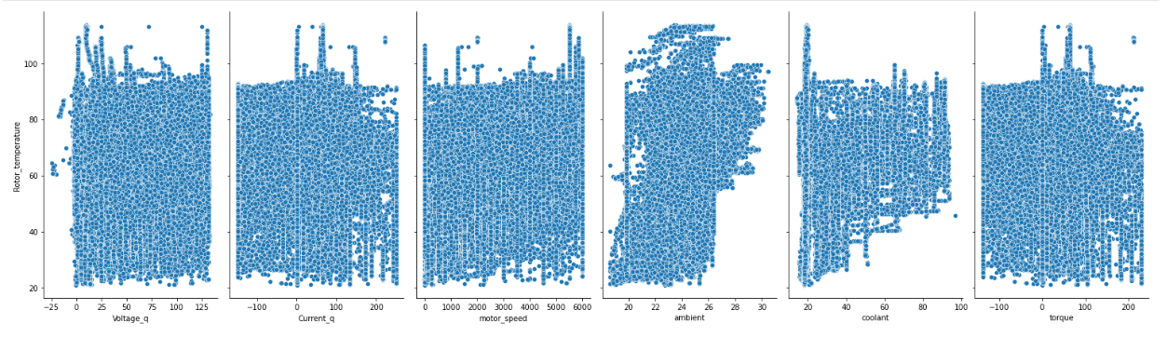
Some Assumptions of Linear Regression Check for Normality
We can see that the variable 'Rotor_temperature' is very Sightly skewed and thus we can say that it is nearly normally distributed.
As in Real life Datasets its impossible to get Perfectly Normally Distributed Datasets
Linearity
From the above plots we can observe that there is no linear relationship between Dependent variables and Independent variable
Followed by Variance Inflation Factor and Multicollarinity.

Slide 18
Different type of models used
XGB
XGBoost, which stands for Extreme Gradient Boosting, is a scalable, distributed gradient-boosted decision tree (GBDT) machine learning library.
Linear Regression
Linear Regression is the supervised Machine Learning model in which the model finds the best fit linear line between the independent and dependent variable i.e it finds the linear relationship between the dependent and independent variable
6.
XGB
6.
XGB
1. Linear Regression
1. Linear Regression
Kneighbors Classifier
KNN works by finding the distances between a query and all the examples in the data, selecting the specified number examples (K) closest to the query, then votes for the most frequent label (in the case of classification) or averages the labels (in the case of regression).
Linear Regression(OLS)
Ordinary Least Squares regression (OLS) is a common technique for estimating coefficients of linear regression equations which describe the relationship between one or more independent quantitative variables and a dependent variable (simple or multiple linear regression).
5.
K-Neighbours
2.
Linear Regression with OLS MODEL
4. Random
Forest
3.
Decision TreeRegressor
Decision Tree
A decision tree is a type of supervised machine learning used to categorize or make predictions based on how a previous set of questions were answered. The model is a form of supervised learning, meaning that the model is trained and tested on a set of data that contains the desired categorization.
Random Forest
Random Forest is a classifier that contains a number of decision trees on various subsets of the given dataset and takes the average to improve the predictive accuracy of that dataset.

Slide 19
7.AdaBoostRegressor
AdaBoostRegressor
An AdaBoost regressor is a meta-estimator that begins by fitting a regressor on the original dataset and then fits additional copies of the regressor on the same dataset but where the weights of instances are adjusted according to the error of the current prediction
8.SGD Regressor
Stochastic Gradient Descent (SGD) regressor basically implements a plain SGD learning routine supporting various loss functions and penalties to fit linear regression models. Scikit-learn provides SGDRegressor module to implement SGD regression
9.LGM Regressor
Light GBM is a fast, distributed, high-performance gradient boosting framework based on a decision tree algorithm, used for ranking, classification and many other machine learning tasks
10.GradientBoostingRegresson
This estimator builds an additive model in a forward stage-wise fashion; it allows for the optimization of arbitrary differentiable loss functions. In each stage a regression tree is fit on the negative gradient of the given loss function.

Slide 20
BEST OF MODELS
Accuracy
Random Forest
01
98%
XGB Regressor
02
96%
Linear Regression (OLS)
03
96%

Slide 21
Conclusions
It is possible to precisely predict motor temperatures with different machine learning Models. It is possible to precisely predict motor temperatures with different machine learning Models
IMPLEMENTATION IN BUSINESS
Motor Productivity and Maintenance
A significant change in Automation Industry
Motor in Electrical Vehicles(EV's)

Slide 22

THANK YOU

